Slide 1
Evaluating Reordering Strategies for Cluster Identification in Parallel Coordinates
Reference to this paper:
Blumenschein, M., Zhang, X., Pomerenke, D., Keim, D.A. and Fuchs, J. (2020), Evaluating Reordering Strategies for Cluster Identification in Parallel Coordinates. Computer Graphics Forum, 39: 537-549. doi:10.1111/cgf.14000
Link:
https://onlinelibrary.wiley.com/doi/pdfdirect/10.1111/cgf.14000

Slide 2
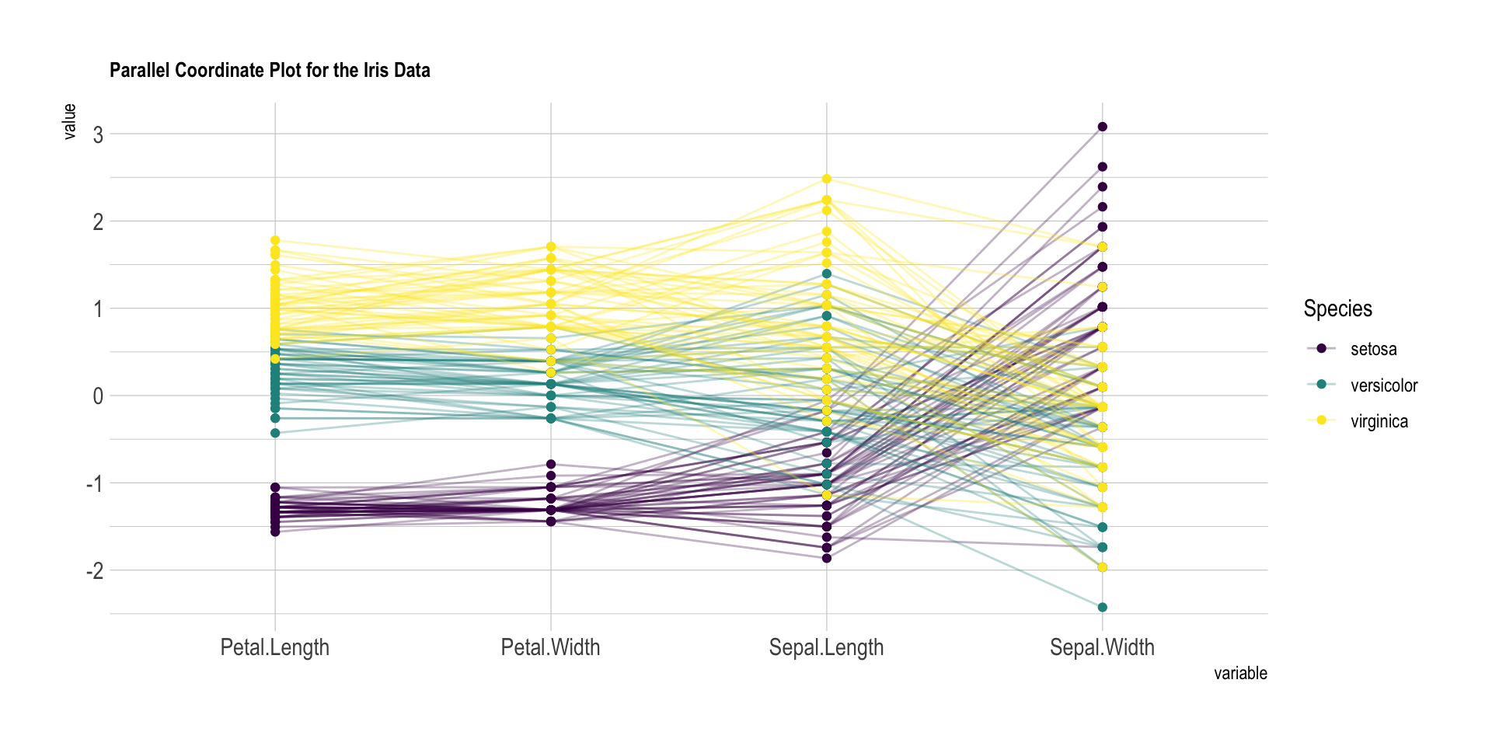
What is Parallel Coordinates?

Slide 3
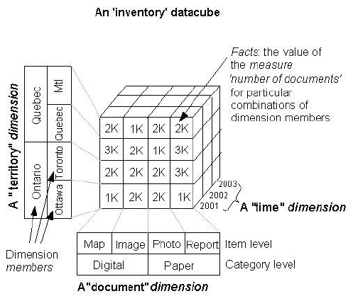
What are the uses of Parallel Coordinates?
Multi dimensional data
Multi dimensional data
PCP’S

Slide 4
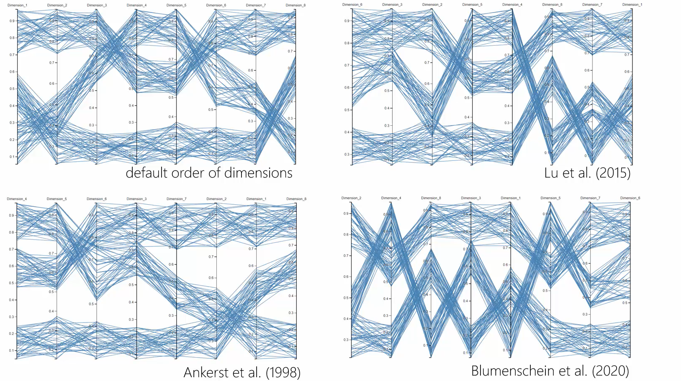
What is the problem?
How to order these axes ???

Slide 5
What is the research gap?
Research Gap
>30 Strategies
Unclear with their usage
Multiple methods for same task
No user study

Slide 6
What is the method proposed?
Reordering classification
Based on pattern
Proposal
Provide guidance
Perform Empirical study
Measure performance

Slide 7
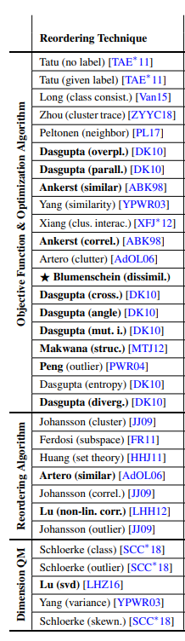
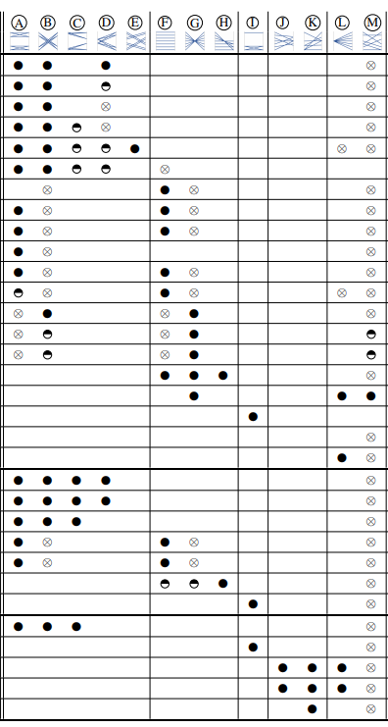
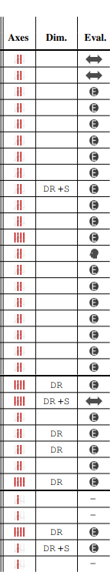
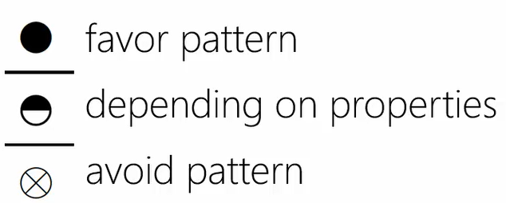
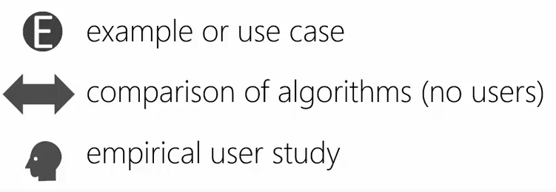
Existing strategies and their classification

Slide 8
Empirical User Study
Focus on cluster identification tasks.
Brute Force
Var1 Var2 Var3 Var4 Var5
Var1 Var2 Var3 Var4 Var5

Slide 9
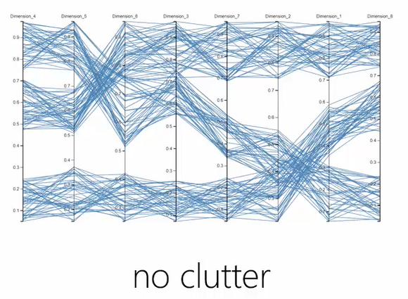
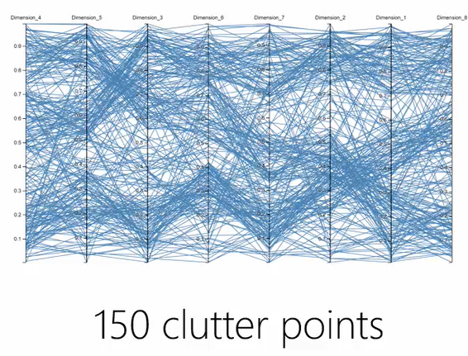
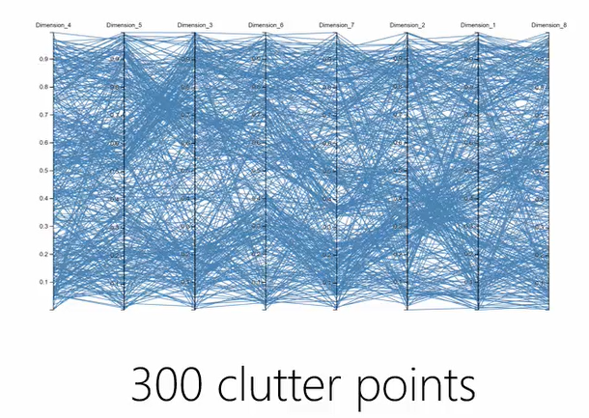
Disadvantages of similarity based PCP

Slide 10
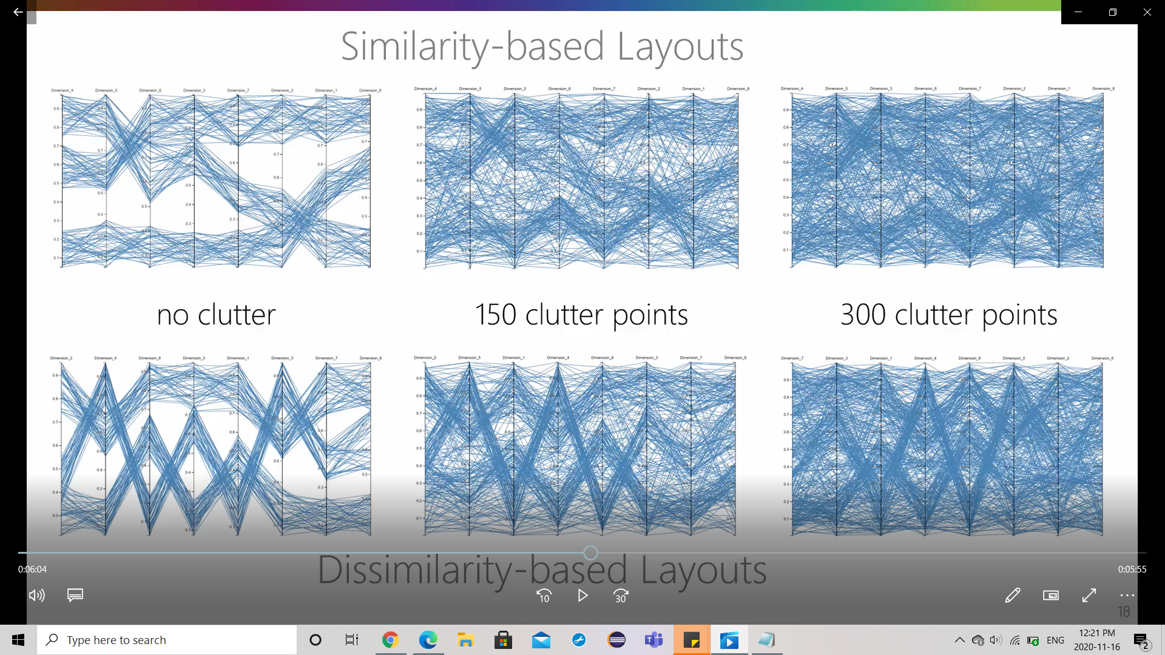
Dis-similarity based PCP’s

Slide 11
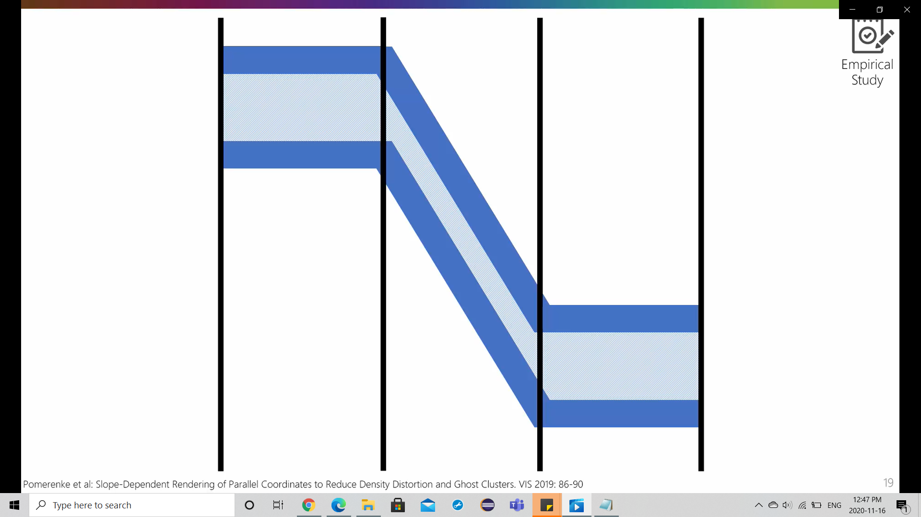
Clusters in dissimilarity based PCP’s
Strong Slopes
Clusters are dense

Slide 12

Hypotheses and user Study
H1: With an increasing amount of clutters the cluster identification drops.
H2: Without clutter, the user perform well in Similarity based PCP’s.
H3: With clutter, the user performs well in dissimilarity based PCP’s
31 Participants with infovis Background.
18 - Male Participants,
13 - Female Participants.
Age - Median = 23
User-study

Slide 13
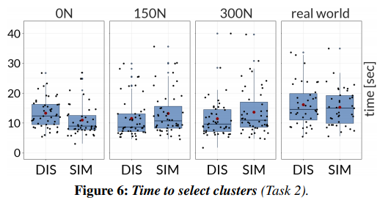
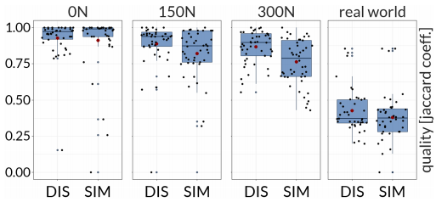
Dataset design and Analysis
Efficiency - Time to select
Dataset
SIM layout
DIS layout
0N Clutter
150N + 300N Clutter
Accuracy

Slide 14
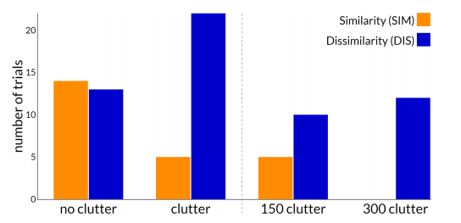
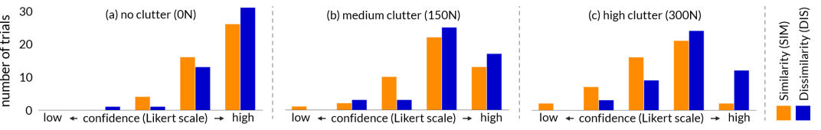
User Preferences

Slide 15
Limitations
Cluster size
1 - 4
Participants
Data points
Per cluster ~50
Limitations
Dimensions
(only 8)
Clutter level
0N, 150N, 300N

Slide 16
Conclusion
Axes reordering in parallel coordinates plots (PCPs)
Classified existing reordering techniques based on their inner workings
1
User study
SIM - No clutter
DIS - Clutter data
Provide guidance
In selecting an appropriate approach for a given task.
2
3

Slide 17
Thanks!

